Slide 1
Konigsberg Bridge Problem
A river Pregel flows around the island Keniphof and then divides into two.
Four land areas A, B, C, D have this river on their borders.
The four lands are connected by 7 bridges a – g.
Determine whether it’s possible to walk across all the bridges exactly once in returning back to the starting land area.

Slide 2
Konigsberg Bridge Problem (Cont.)
c
C
d
g
A
Kneiphof
e
D
C
f
g
a
B
c
d
b
e
A
D
a
b
f
B

Slide 3
Euler’s Graph
Define the degree of a vertex to be the number of edges incident to it
Euler showed that there is a walk starting at any vertex, going through each edge exactly once and terminating at the start vertex iff the degree of each vertex is even. This walk is called Eulerian.
No Eulerian walk of the Konigsberg bridge problem since all four vertices are of odd edges.

Slide 4
Application of Graphs
Analysis of electrical circuits
Finding shortest routes
Project planning
Identification of chemical compounds
Statistical mechanics
Genertics
Cybernetics
Linguistics
Social Sciences, and so on …

Slide 5
Definition of A Graph
A graph, G, consists tof two sets, V and E.
  V is a finite, nonempty set of vertices.
  E is set of pairs of vertices called edges.
The vertices of a graph G can be represented as V(G).
Likewise, the edges of a graph, G, can be represented as E(G).
Graphs can be either undirected graphs or directed graphs.
For a undirected graph, a pair of vertices (u, v) or (v, u) represent the same edge.
For a directed graph, a directed pair <u, v> has u as the tail and the v as the head. Therefore, <u, v> and <v, u> represent different edges.

Slide 6
Three Sample Graphs
0
0
0
1
2
1
2
1
3
3
4
5
6
2
V(G₁) = {0, 1, 2, 3}
V(G₂) = {0, 1, 2, 3, 4, 5, 6}
V(G₃) = {0, 1, 2}
E(G₁) = {(0, 1), (0, 2), (0, 3), (1, 2), (1, 3), (2, 3)}
E(G₂) = {(0, 1), (0, 2), (1, 3), (1, 4), (2, 5), (2, 6)}
E(G₃) = {<0, 1>, <1, 0>, <1, 2>}
(a) G₁
(b) G₂
(c) G₃

Slide 7
Graph Restrictions
A graph may not have an edge from a vertex back to itself.
  (v, v) or <v, v> are called self edge or self loop. If a graph with self edges, it is called a graph with self edges.
A graph man not have multiple occurrences of the same edge.
  If without this restriction, it is called a multigraph.

Slide 8
Complete Graph
The number of distinct unordered pairs (u, v) with u≠v in a graph with n vertices is n(n-1)/2.
A complete unordered graph is an unordered graph with exactly n(n-1)/2 edges.
A complete directed graph is a directed graph with exactly n(n-1) edges.

Slide 9
Examples of Graphlike Structures
0
0
1
1
3
2
2
(a) Graph with a self edge
(b) Multigraph

Slide 10
Graph Edges
If (u, v) is an edge in E(G), vertices u and v are adjacent and the edge (u, v) is the incident on vertices u and v.
For a directed graph, <u, v> indicates u is adjacent to v and v is adjacent from u.

Slide 11

Subgraph and Path
Subgraph: A subgraph of G is a graph G’ such that V(G’) V(G) and E(G’) E(G).
Path: A path from vertex u to vertex v in graph G is a sequence of vertices u, i₁, i₂, …, i_{k}, v, such that (u, i₁), (i₁, i₂), …, (i_{k}, v) are edges in E(G).
  The length of a path is the number of edges on it.
  A simple path is a path in which all vertices except possibly the first and last are distinct.
  A path (0, 1), (1, 3), (3, 2) can be written as 0, 1, 3, 2.
Cycle: A cycle is a simple path in which the first and last vertices are the same.
Similar definitions of path and cycle can be applied to directed graphs.

Slide 12
G₁ and G₃ Subgraphs
0
0
0
1
2
1
2
1
2
3
(i)
(ii)
(iii)
(iv)
3
(a) Some subgraphs of G₁
0
0
0
0
1
1
1
(i)
(ii)
2
2
2
(a) Some subgraphs of G₃
(iii)
(iv)

Slide 13
Connected Graph
Two vertices u and v are connected in an undirected graph iff there is a path from u to v (and v to u).
An undirected graph is connected iff for every pair of distinct vertices u and v in V(G) there is a path from u to v in G.
A connected component of an undirected is a maximal connected subgraph.
A tree is a connected acyclic graph.

Slide 14
Strongly Connected Graph
A directed graph G is strongly connected iff for every pair of distinct vertices u and v in V(G), there is directed path from u to v and also from v to u.
A strongly connected component is a maximal subgraph that is strongly connected.

Slide 15
Graphs with Two Connected Components
H₁
H₂
0
0
1
2
1
2
3
3
G₄

Slide 16
Strongly Connected Components of G₃
0
1
2

Slide 17
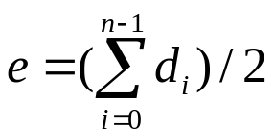
Degree of A Vertex
Degree of a vertex: The degree of a vertex is the number of edges incident to that vertex.
If G is a directed graph, then we define
  in-degree of a vertex: is the number of edges for which vertex is the head.
  out-degree of a vertex: is the number of edges for which the vertex is the tail.
For a graph G with n vertices and e edges, if d_{i} is the degree of a vertex i in G, then the number of edges of G is

Slide 18
Abstract of Data Type Graphs
class Graph
{
// objects: A nonempty set of vertices and a set of undirected edges
// where each edge is a pair of vertices
public:
Graph(); // Create an empty graph
void InsertVertex(Vertex v);
void InsertEdge(Vertex u, Vertex v);
void DeleteVertex(Vertex v);
void DeleteEdge(Vertex u, Vertex v);
Boolean IsEmpty(); // if graph has no vertices return TRUE
List<List> Adjacent(Vertex v);
// return a list of all vertices that are adjacent to v
};

Slide 19
Adjacent Matrix
Let G(V, E) be a graph with n vertices, n ≥ 1. The adjacency matrix of G is a two-dimensional nxn array, A.
  A[i][j] = 1 iff the edge (i, j) is in E(G).
  The adjacency matrix for a undirected graph is symmetric, it may not be the case for a directed graph.
For an undirected graph the degree of any vertex i is its row sum.
For a directed graph, the row sum is the out-degree and the column sum is the in-degree.

Slide 20
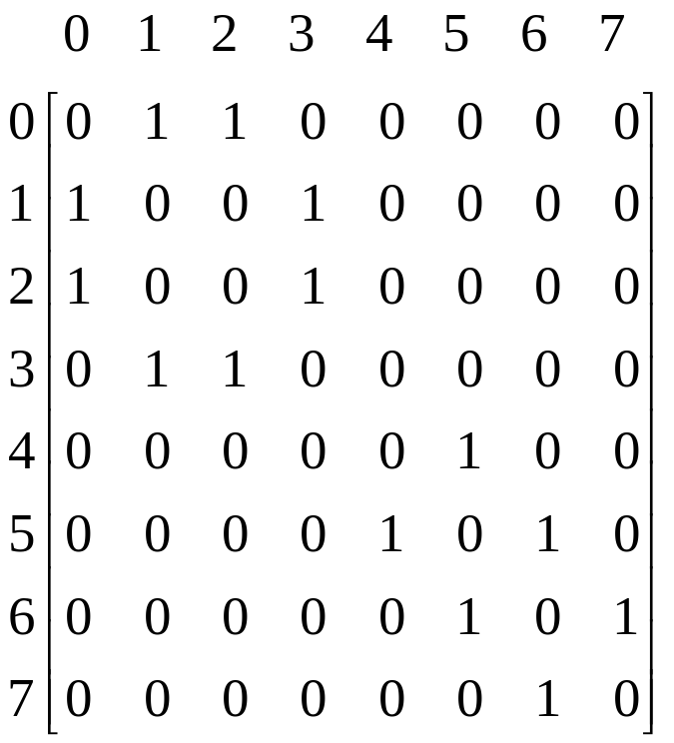
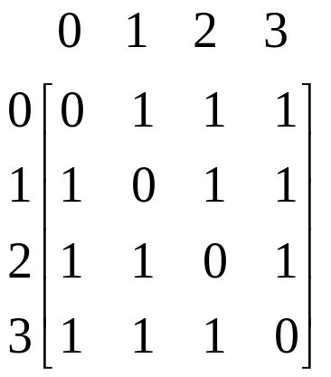
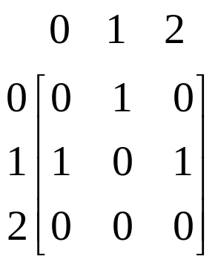
Adjacency Matrices
(a) G₁
(b) G₃
(c) G₄

Slide 21
Adjacency Lists
Instead of using a matrix to represent the adjacency of a graph, we can use n linked lists to represent the n rows of the adjacency matrix.
Each node in the linked list contains two fields: data and link.
  data: contain the indices of vertices adjacent to a vertex i.
  Each list has a head node.
For an undirected graph with n vertices and e edges, we need n head nodes and 2e list nodes.
The degree of any vertex may be determined by counting the number nodes in its adjacency list.
The number of edges in G can be determined in O(n + e).
For a directed graph (also called digraph),
  the out-degree of any vertex can be determined by counting the number of nodes in its adjacency list.
  the in-degree of any vertex can be obtained by keeping another set of lists called inverse adjacency lists.

Slide 22
Adjacent Lists
HeadNodes
[0]
3
1
2
0
[1]
2
3
0
0
[2]
1
3
0
0
[3]
0
1
2
0
(a) G₁
HeadNodes
[0]
1
0
[1]
2
0
0
[2]
0
(b) G₃

Slide 23
Adjacent Lists (Cont.)
HeadNodes
[0]
2
1
0
[1]
3
0
0
[2]
0
3
0
[3]
1
1
0
[4]
5
0
[5]
6
4
0
[6]
5
7
0
[7]
6
0
(c) G₄

Slide 24
Sequential Representation of Graph G₄
0
1
2
3
4
5
6
7
8
9
10
11
12
13
14
15
16
17
18
19
20
21
22
9
11
13
15
17
18
20
22
23
2
1
3
0
0
3
1
2
5
6
4
5
7
6

Slide 25
Inverse Adjacency Lists for G₃
[0]
1
0
[1]
0
0
[2]
1
0

Slide 26
Multilists
In the adjacency-list representation of an undirected graph, each edge (u, v) is represented by two entries.
Multilists: To be able to determine the second entry for a particular edge and mark that edge as having been examined, we use a structure called multilists.
  Each edge is represented by one node.
  Each node will be in two lists.

Slide 27
Orthogonal List Representation for G₃
head nodes (shown twice)
0
1
2
0
0
1
0
0
1
1
0
0
1
2
0
0
2
0

Slide 28
Adjacency Multilists for G₁
HeadNodes
[0]
N0
0
1
N1
N3
edge (0, 1)
[1]
N1
0
2
N2
N3
edge (0, 2
[2]
[3]
N2
0
3
0
N4
edge (0, 3)
N3
1
2
N4
N5
edge (1, 2)
The lists are
N4
1
3
0
N5
edge (1, 3)
Vertex 0: N0 -> N1 -> N2
Vertex 1: N0 -> N3 -> N4
N5
2
3
0
0
edge (2, 3)
Vertex 2: N1 -> N3 -> N5
Vertex 3: N2 -> N4 -> N5

Slide 29
Weighted Edges
Very often the edges of a graph have weights associated with them.
  distance from one vertex to another
  cost of going from one vertex to an adjacent vertex.
  To represent weight, we need additional field, weight, in each entry.
  A graph with weighted edges is called a network.

Slide 30
Graph Operations
A general operation on a graph G is to visit all vertices in G that are reachable from a vertex v.
  Depth-first search
  Breath-first search

Slide 31
Depth-First Search
Starting from vertex, an unvisited vertex w adjacent to v is selected and a depth-first search from w is initiated.
When the search operation has reached a vertex u such that all its adjacent vertices have been visited, we back up to the last vertex visited that has an unvisited vertex w adjacent to it and initiate a depth-first search from w again.
The above process repeats until no unvisited vertex can be reached from any of the visited vertices.

Slide 32
Graph G and Its Adjacency Lists
0
1
2
3
4
5
6
HeadNodes
[0]
1
2
0
7
[1]
0
3
4
0
[2]
0
5
6
0
[3]
1
7
0
[4]
1
7
0
[5]
2
7
0
[6]
2
7
0
[7
3
4
5
6
0

Slide 33
Analysis of DFS
If G is represented by its adjacency lists, the DFS time complexity is O(e).
If G is represented by its adjacency matrix, then the time complexity to complete DFS is O(n²).

Slide 34
Breath-First Search
Starting from a vertex v, visit all unvisited vertices adjacent to vertex v.
Unvisited vertices adjacent to these newly visited vertices are then visited, and so on.
If an adjacency matrix is used, the BFS complexity is O(n²).
If adjacency lists are used, the time complexity of BFS is O(e).

Slide 35
A Complete Graph and Three of Its Spanning Trees

Slide 36
Depth-First and Breath-First Spanning Trees
0
0
1
2
1
2
3
4
5
6
3
4
5
6
7
7
(a) DFS (0) spanning tree
(b) BFS (0) spanning tree

Slide 37
Spanning Tree
Any tree consisting solely of edges in G and including all vertices in G is called a spanning tree.
Spanning tree can be obtained by using either a depth-first or a breath-first search.
When a nontree edge (v, w) is introduced into any spanning tree T, a cycle is formed.
A spanning tree is a minimal subgraph, G’, of G such that V(G’) = V(G), and G’ is connected. (Minimal subgraph is defined as one with the fewest number of edges).
Any connected graph with n vertices must have at least n-1 edges, and all connected graphs with n – 1 edges are trees. Therefore, a spanning tree has n – 1 edges.

Slide 38
A Connected Graph and Its Biconnected Components
0
8
9
0
8
9
1
7
1
7
7
2
3
5
1
7
4
6
2
3
3
5
5
4
6
(a) A connected graph
(b) Its biconnected components

Slide 39
Biconnected Components
Definition: A vertex v of G is an articulation point iff the deletion of v, together with the deletion of all edges incident to v, leaves behind a graph that has at least two connected components.
Definition: A biconnected graph is a connected graph that has no articulation points.
Definition: A biconnected component of a connected graph G is a maximal biconnected subgraph H of G. By maximal, we mean that G contains no other subgraph that is both biconnected and properly contains H.

Slide 40
Biconnected Components (Cont.)
Two biconnected components of the same graph can have at most one vertex in common.
No edge can be in two or more biconnected components.
The biconnected components of G partition the edges of G.
The biconnected components of a connected, undirected graph G can be found by using any depth-first spanning tree of G.
A nontree edge (u, v) is a back edge with respect to a spanning tree T iff either u is an ancestor of v or v is an ancestor of u.
A nontree edge that is not back edge is called a cross edge.
No graph can have cross edges with respect to any of its depth-first spanning trees.

Slide 41
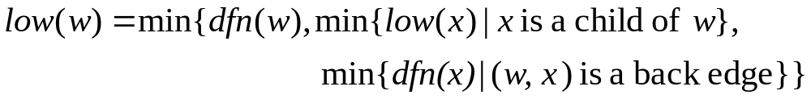
Biconnected Components (Cont.)
The root of the depth-first spanning tree is an articulation point iff it has at least two children.
Any other vertex u is an articulation point iff it has at least one child, w, such that it is not possible to reach an ancestor of u using apath composed solely of w, descendants of w, and a single back edge.
Define low(w) as the lowest depth-first number that can be reached fro w using a path of descendants followed by, at most, one back edge.

Slide 42
u is an articulation point iff u is either the root of the spanning tree and has two or more children or u is not the root and u has a child w such that low(w) ≥ dfn(u).

Slide 43
Depth-First Spanning Tree
1
3
5
0
10
8
9
9
2
6
4
5
4
1
7
8
1
6
3
2
7
6
3
2
3
5
4
1
8
7
4
6
2
7
5
0
9
8
9
10

Slide 44
dfn and low values for the Spanning Tree
vertex | 0 | 1 | 2 | 3 | 4 | 5 | 6 | 7 | 8 | 9
dfn | 5 | 4 | 3 | 1 | 2 | 6 | 7 | 8 | 10 | 9
low | 5 | 1 | 1 | 1 | 1 | 6 | 6 | 6 | 10 | 9

Slide 45
Minimal Cost Spanning Tree
The cost of a spanning tree of a weighted, undirected graph is the sum of the costs (weights) of the edges in the spanning tree.
A minimum-cost spanning tree is a spanning tree of least cost.
Three greedy-method algorithms available to obtain a minimum-cost spanning tree of a connected, undirected graph.
  Kruskal’s algorithm
  Prim’s algorithm
  Sollin’s algorithm

Slide 46
Kruskal’s Algorithm
Kruskal’s algorithm builds a minimum-cost spanning tree T by adding edges to T one at a time.
The algorithm selects the edges for inclusion in T in nondecreasing order of their cost.
An edge is added to T if it does not form a cycle with the edges that are already in T.
Theorem 6.1: Let G be any undirected, connected graph. Kruskal’s algorithm generates a minimum-cost spanning tree.

Slide 47
Stages in Kruskal’s Algorithm
0
28
0
0
10
1
1
1
10
14
16
5
6
2
5
6
2
5
6
2
24
18
25
12
4
4
4
22
3
3
3
(a)
(b)
(c)

Slide 48
Stages in Kruskal’s Algorithm (Cont.)
0
0
0
10
1
1
1
10
10
14
14
16
5
6
2
5
6
2
5
6
2
4
12
12
12
4
4
3
3
3
(d)
(e)
(f)

Slide 49
Stages in Kruskal’s Algorithm (Cont.)
0
0
1
10
1
10
14
16
14
16
5
6
2
5
6
2
25
12
12
4
4
3
22
3
22
(g)
(g)

Slide 50
Prim’s Algorithm
Similar to Kruskal’s algorithm, Prim’s algorithm constructs the minimum-cost spanning tree edge by edge.
The difference between Prim’s algorithm and Kruskal’s algorithm is that the set of selected edges forms a tree at all times when using Prim’s algorithm while a forest is formed when using Kruskal’s algorithm.
In Prim’s algorithm, a least-cost edge (u, v) is added to T such that T∪ {(u, v)} is also a tree. This repeats until T contains n-1 edges.
Prim’s algorithm in program 6.7 has a time complexity O(n²).

Slide 51
Stages in Prim’s Alogrithm
0
0
0
10
1
10
1
1
10
5
6
2
5
6
2
5
6
2
25
25
4
4
4
3
3
22
3
(a)
(b)
(c)

Slide 52
Stages in Prim’s Alogrithm (Cont.)
0
0
0
1
1
10
1
10
10
16
14
16
5
6
2
5
6
2
5
6
2
25
12
25
12
25
12
4
4
4
22
3
22
3
22
3
(d)
(e)
(f)

Slide 53
Sollin’s Algorithm
Contrast to Kruskal’s and Prim’s algorithms, Sollin’s algorithm selects multiple edges at each stage.
At the beginning, the selected edges and all the n vertices form a spanning forest.
During each stage, an minimum-cost edge is selected for each tree in the forest.
It’s possible that two trees in the forest to select the same edge. Only one should be used.
Also, it’s possible that the graph has multiple edges with the same cost. So, two trees may select two different edges that connect them together. Again, only one should be retained.

Slide 54
Stages in Sollin’s Algorithm
0
0
1
10
1
10
14
14
16
5
6
2
5
6
2
25
12
12
4
4
3
22
3
22
(a)
(b)

Slide 55
Shortest Paths
Usually, the highway structure can be represented by graphs with vertices representing cities and edges representing sections of highways.
Edges may be assigned weights to represent the distance or the average driving time between two cities connected by a highway.
Often, for most drivers, it is desirable to find the shortest path from the originating city to the destination city.

Slide 56
Single Source/All Destinations: Nonnegative Edge Costs
Let S denotes the set of vertices to which the shortest paths have already been found.
  If the next shortest path is to vertex u, then the path begins at v, ends at u, and goes through only vertices that are in S.
  The destination of the next path generated must be the vertex u that has the minimum distance among all vertices not in S.
  The vertex u selected in 2) becomes a member of S.
The algorithm is first given by Edsger Dijkstra. Therefore, it’s sometimes called Dijstra Algorithm.

Slide 57
Single Source/All Destinations: General Weights
When negative edge lengths are permitted, the graph must not have cycles of negative length.
When there are no cycles of negative length, there is a shortest path between any two vertices of an n-vertex graph that has at most n-1 edges on it.
  If the shortest paht from v to u with at most k, k > 1, edges has no more than k – 1 edges, then dist^{k}[u] = dist^{k-1}[u].
  If the shortest path from v to u with at most k, k > 1, edges has exactly k edges, then it is comprised of a shortest path from v to some vertex j followed by the edge <j, u>. The path from v to j has k – 1 edges, and its length is dist^{k-1}[j].
The distance can be computed in recurrence by the following:
The algorithm is also referred to as the Bellman and Ford Algorithm.

Slide 58
Graph and Shortest Paths From Vertex 0 to all destinations
50
10
0
1
2
Path
Length
15
35
1) 0, 3
10
10
20
20
30
2) 0, 3, 4
25
3
4
5
3) 0, 3, 4, 1
45
15
3
4) 0, 2
45
(a) Graph
(b) Shortest paths from 0

Slide 59
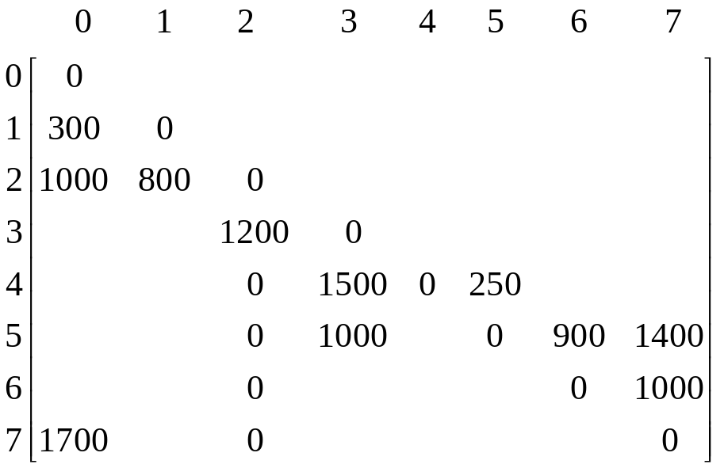
Diagram for Example 6.5
Chicago
1500
0
Boston
1200
0
1000
250
San Francisco
800
0
0
0
New York
Denver
1400
300
1000
900
0
1700
0
1000
Los Angeles
New Orleans
0
Miami

Slide 60
Action of Shortest Path
iteration | S | Vertex selected | Distance
 |  |  | LA | SF | DEN | CHI | BOST | NY | MIA | NO
 |  |  | [0] | [1] | [2] | [3] | [4] | [5] | [6] | [7]
Initial | -- | --- | +∞ | +∞ | +∞ | 1500 | 0 | 250 | +∞ | +∞
1 | {4} | 5 | +∞ | +∞ | +∞ | 1250 | 0 | 250 | 1150 | 1650
2 | {4,5} | 6 | +∞ | +∞ | +∞ | 1250 | 0 | 250 | 1150 | 1650
3 | {4,5,6} | 3 | +∞ | +∞ | 2450 | 1250 | 0 | 250 | 1150 | 1650
4 | {4,5,6,3} | 7 | 3350 | +∞ | 2450 | 1250 | 0 | 250 | 1150 | 1650
5 | {4,5,6,3,7} | 2 | 3350 | 3250 | 2450 | 1250 | 0 | 250 | 1150 | 1650
6 | {4,5,6,3,7,2} | 1 | 3350 | 3250 | 2450 | 1250 | 0 | 250 | 1150 | 1650
 | {4,5,6,3,7,2,1}

Slide 61
Directed Graphs
5
0
7
1
-5
2
(a) Directed graph with a negative-length edge
-2
0
1
2
1
1
(b) Directed graph with a cycle of negative length

Slide 62
Shortest Paths with Negative Edge Lengths
k | dist^{k}[7]
 | 0 | 1 | 2 | 3 | 4 | 5 | 6
1 | 0 | 6 | 5 | 5 | ∞ | ∞ | ∞
2 | 0 | 3 | 3 | 5 | 5 | 4 | ∞
3 | 0 | 1 | 3 | 5 | 2 | 4 | 7
4 | 0 | 1 | 3 | 5 | 0 | 4 | 5
5 | 0 | 1 | 3 | 5 | 0 | 4 | 3
6 | 0 | 1 | 3 | 5 | 0 | 4 | 3
1
4
0
2
6
3
5
(a) A directed graph
(b) dist^{k}

Slide 63
All-Pairs Shortest Paths
In all-pairs shortest-path problem, we are to find the shortest paths between all pairs of vertices u and v, u ≠ v.
  Use n independent single-source/all-destination problems using each of the n vertices of G as a source vertex. Its complexity is O(n³) (or O(n² logn + ne) if Fibonacci heaps are used).
  On graphs with negative edges the run time will be O(n⁴). if adjacency matrices are used and O(n²e) if adjacency lists are used.

Slide 64
All-Pairs Shortest Paths (Cont.)
A simpler algorithm with complexity O(n³) is available. It works faster when G has edges with negative length, as long as the graphs have at least c*n edges for some suitable constant c.
  A^{n-1}[i][j]: the length of the shortest i-to-j path in G
  A^{k}[i][j]: the length of the shortest path from I to j going through no intermediate vertex of index greater than k.
  A⁻¹[i][j]: is just the length[i][j]
The shortest path from i to j going through no vertex with index greater than k does not go through the vertex with index k. so its length is A^{k-1}[i][j].
The shortest path goes through vertex k. The path consists of subpath from i to k and another one from k to j.
A^{k}[i][j] = min{A^{k-1}[i][j], A^{k-1}[i][k]+ A^{k-1}[k][j] }, k ≥ 0

Slide 65
Example for All-Pairs Shortest-Paths Problem
A⁻¹ | 0 | 1 | 2
0 | 0 | 4 | 11
1 | 6 | 0 | 2
2 | 3 | ∞ | 0
A⁰ | 0 | 1 | 2
0 | 0 | 4 | 11
1 | 6 | 0 | 2
2 | 3 | 7 | 0
6
0
1
4
(b) A⁻¹
(c) A⁰
11
2
3
2
A¹ | 0 | 1 | 2
0 | 0 | 4 | 6
1 | 6 | 0 | 2
2 | 3 | 7 | 0
A² | 0 | 1 | 2
0 | 0 | 4 | 6
1 | 5 | 0 | 2
2 | 3 | 7 | 0
(d) A¹
(e) A²

Slide 66
Transitive Closure
Definition: The transitive closure matrix, denoted A⁺, of a graph G, is a matrix such that A⁺[i][j] = 1 if there is a path of length > 0 fromi to j; otherwise, A*[i][j] = 0.
Definition: The reflexive transitive closure matrix, denoted A*, of a graph G, is a matrix such that A*[i][j] = 1 if there is a path of length 0 from i to j; otherwise, A*[i][j] = 0.

Slide 67
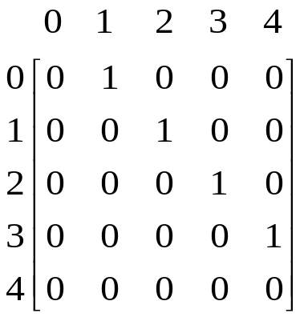
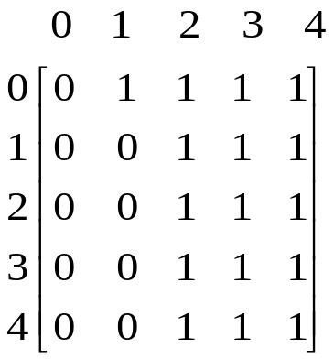
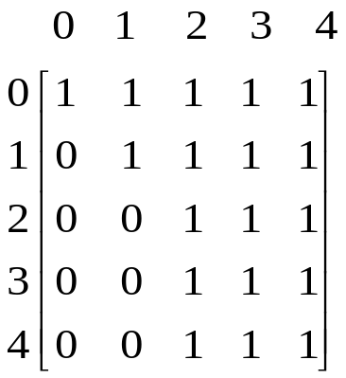
Graph G and Its Adjacency Matrix A, A⁺, A*
0
1
2
3
4
(a) Digraph G
(b) Adjacency matrix A
(c) A⁺
(d) A*

Slide 68
Activity-on-Vertex (AOV) Networks
Definition: A directed graph G in which the vertices represent tasks or activities and the edges represent precedence relations between tasks is an activity-on-vertex network or AOV network.
Definition: Vertex i in an AOV network G is a predecessor of vertex j iff there is a directed path from vertex i to vertex j. i is an immediate predecessor of j iff <i, j> is an edge in G. If i is a predecessor of j, then j is an successor of i. If i is an immediate predecessor of j, then j is an immediate successor of i.

Slide 69
Activity-on-Vertex (AOV) Networks (Cont.)
Definition: A relation · is transitive iff it is the case that for all triples, i, j, k, i.j and j·k => i·k. A relation · is irreflexive on a set S if for no element x in S it is the case that x·x. A precedence relation that is both transitive and irreflexive is a partial order.
Definition: A topological order is a linear ordering of the vertices of a graph such that, for any two vertices I and j, if I is a predecessor of j in the network, then i precedes j in the linear ordering.

Slide 70
An Activity-on-Vertex (AOV) Network
Course number | Course name | Prerequisites
C1 | Programming I | None
C2 | Discrete Mathematics | None
C3 | Data Structures | C1, C2
C4 | Calculus I | None
C5 | Calculus II | C4
C6 | Linear Algebra | C5
C7 | Analysis of Algorithms | C3, C6
C8 | Assembly Language | C3
C9 | Operating Systems | C7, C8
C10 | Programming Languages | C7
C11 | Compiler Design | C10
C12 | Artificial Intelligence | C7
C13 | Computational Theory | C7
C14 | Parallel Algorithms | C13
C15 | Numerical Analysis | C5

Slide 71
An Activity-on-Vertex (AOV) Network (Cont.)
C9
C10
C11
C1
C8
C12
C2
C3
C7
C13
C14
C4
C5
C6
C15

Slide 72
Figure 6.36 Action of Program 6.11 on an AOV network
1
1
1
0
2
4
2
4
2
4
3
5
3
5
5
(a) Initial
(b) Vertex 0 deleted
(c) Vertex 3 deleted
1
1
4
4
4
5
(d) Vertex 2 deleted
(e) Vertex 5 deleted
(f) Vertex 1 deleted

Slide 73
Figure 6.37 Internal representation used by topological sorting algorithm
count
first
data
link
[0]
0
1
2
3
0
[1]
1
4
0
[2]
1
4
5
0
[3]
1
5
4
0
[4]
3
0
[5]
2
0

Slide 74
An AOE Network
a₁ = 6
1
6
a₁₀ = 2
a₄ = 6
a₇= 9
start
0
4
8
finish
a₂ = 4
a₅ = 1
a₁₁ = 4
2
7
a₃ = 5
a₉ = 4
3
5
a₆ = 2
event | interpretation
0 | Start of project
1 | Completion of activity a₁
4 | Completion of activities a₄ and a₅
7 | Completion of activities a₈ and a₉
8 | Completion of project

Slide 75
Adjacency lists for Figure 6.38 (a)
count
first
vertex
dur
link
[0]
0
1
6
2
4
3
5
0
[1]
1
4
1
0
[2]
1
4
1
0
[3]
1
5
2
0
[4]
3
6
9
7
7
0
[5]
2
7
4
0
[6]
2
8
2
0
[7]
2
8
4
0
[8]
2
0

Slide 76
Computation of ee
ee | [0] | [1] | [2] | [3] | [4] | [5] | [6] | [7] | [8] | Stack
Initial | 0 | 0 | 0 | 0 | 0 | 0 | 0 | 0 | 0 | [0]
output 0 | 0 | 6 | 4 | 5 | 0 | 0 | 0 | 0 | 0 | [3,2,1]
output 3 | 0 | 6 | 4 | 5 | 0 | 7 | 0 | 0 | 0 | [5,2,1]
output 5 | 0 | 6 | 4 | 5 | 0 | 7 | 0 | 11 | 0 | [2,1]
output 2 | 0 | 6 | 4 | 5 | 0 | 7 | 0 | 11 | 0 | [1]
output 1 | 0 | 6 | 4 | 5 | 5 | 7 | 0 | 11 | 0 | [4]
output 4 | 0 | 6 | 4 | 5 | 7 | 7 | 0 | 14 | 0 | [7,6]
output 7 | 0 | 6 | 4 | 5 | 7 | 7 | 16 | 14 | 18 | [6]
output 6 | 0 | 6 | 4 | 5 | 7 | 7 | 16 | 14 | 18 | [8]
output 8

